Slide 1


TCS3254
PROGRAMMING FOR
MOBILE DEVICES
TCS3254
PROGRAMMING FOR
MOBILE DEVICES
WEB AND MOBILE
DEVELOPMENT
MOBILE DEVELOPMENT ENVIRONMENT SETUP
Building Layout using Widgets
Application Environment and Framework
1
1

Slide 2
Introduction
Setting up the right development environment is crucial for building mobile applications efficiently and effectively.
In this course, we will focus on Flutter, a popular framework for building cross-platform mobile apps with a single codebase.
Flutter is known for its fast development cycle, rich set of pre-designed widgets, and performance optimization.

Slide 3
Setting up the Development Environment
Setup Flutter SDK:
https://flutter.dev/docs/get-started/install
Get editors:
  Android Studio:
  https://developer.android.com/studio
  VS Code:
  https://code.visualstudio.com/
Install Dart and Flutter

Slide 4
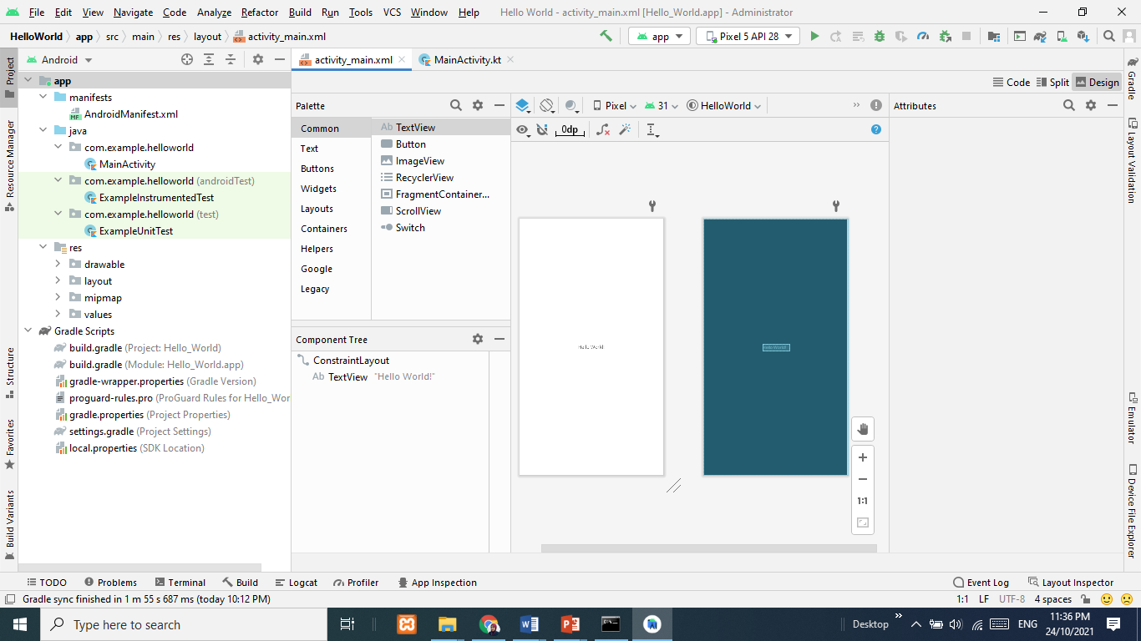
Android Studio IDE

Slide 5
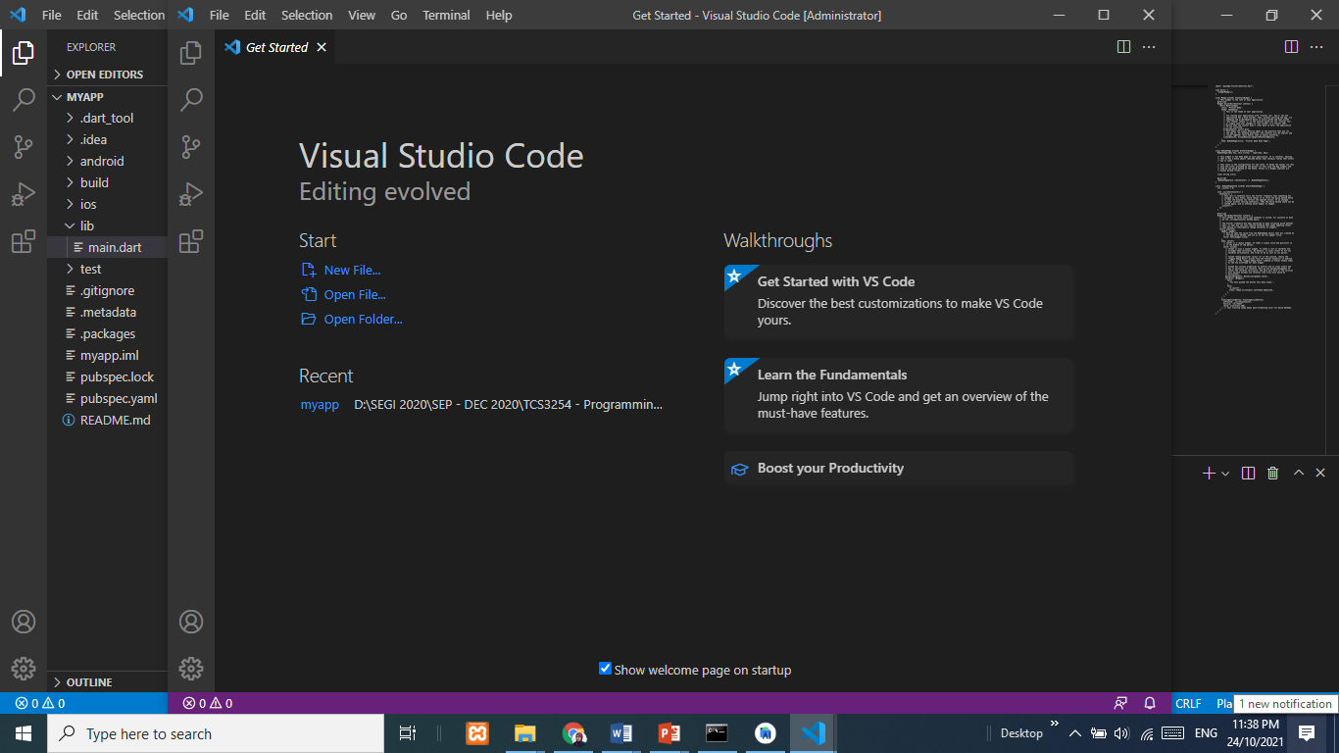
Visual Studio Code

Slide 6
Creating Android Virtual Devices (AVDs)
An AVD is an emulator instance that enables you to model an actual device.
It mimics real Android devices such as smartphones, tablets, and wearables, offering features like different screen sizes, resolutions, and Android versions.
The emulator is good for doing some generalized testing of the applications.

Slide 7
Creating Android Virtual Devices (AVDs)
Key Features of AVD:
  Device Simulation: simulate a wide range of Android hardware, including different screen sizes, processors, memory, and other device characteristics.
  Android Version Testing: allows testing on different Android versions (APIs) to ensure compatibility and performance across various releases of the Android OS.
  Screen Orientation: to switch between portrait and landscape orientations
  Real-time Testing: run app in real-time and interact with it, testing UI, gestures, touch input, etc.
  Sensors & Features: simulate device features like GPS, cellular network, Wi-Fi, cameras, and sensors.

Slide 8
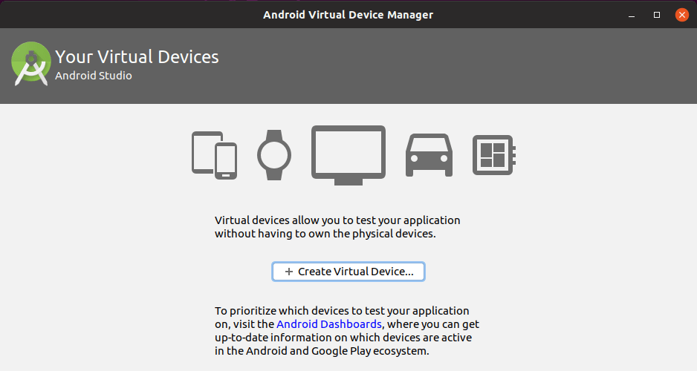
Creating Android Virtual Devices (AVDs)
Creating AVD:

Slide 9
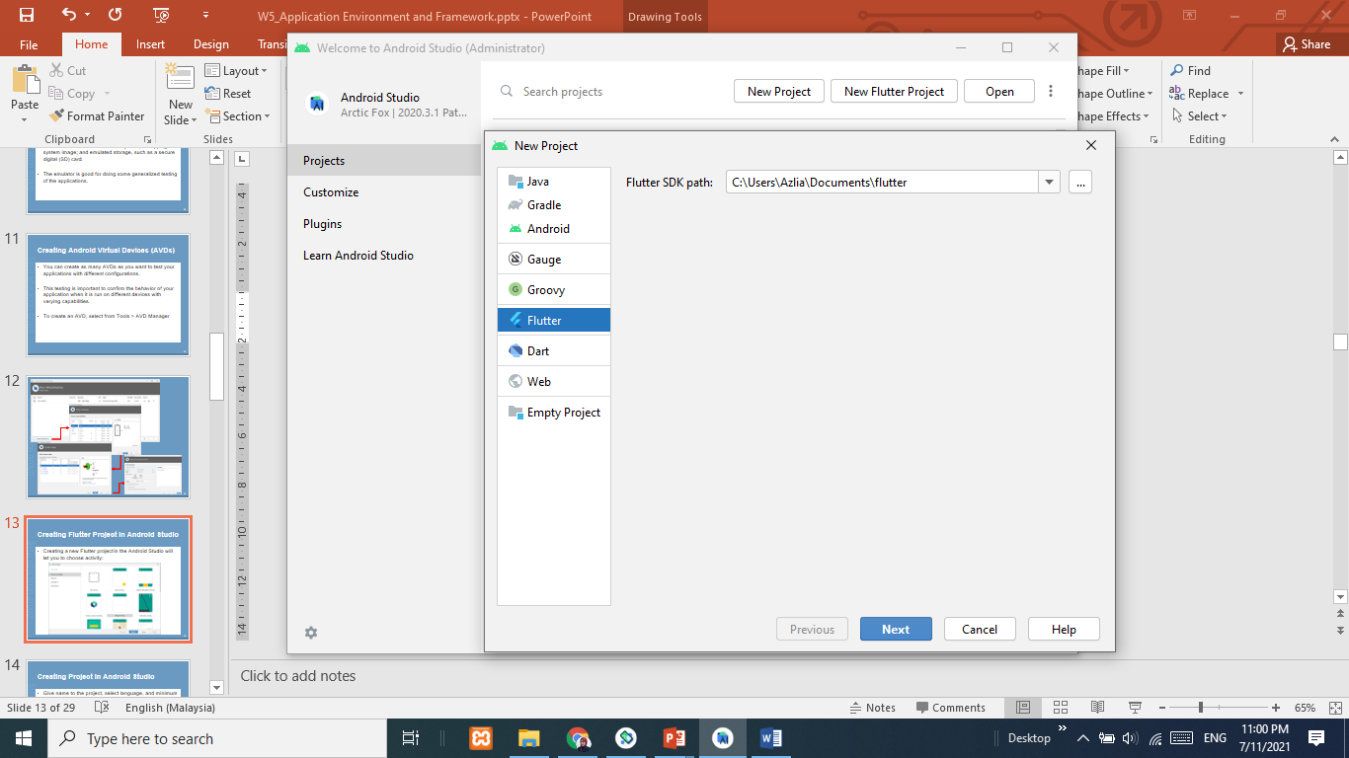
Creating Flutter Project in Android Studio
Creating a new Flutter project:

Slide 10
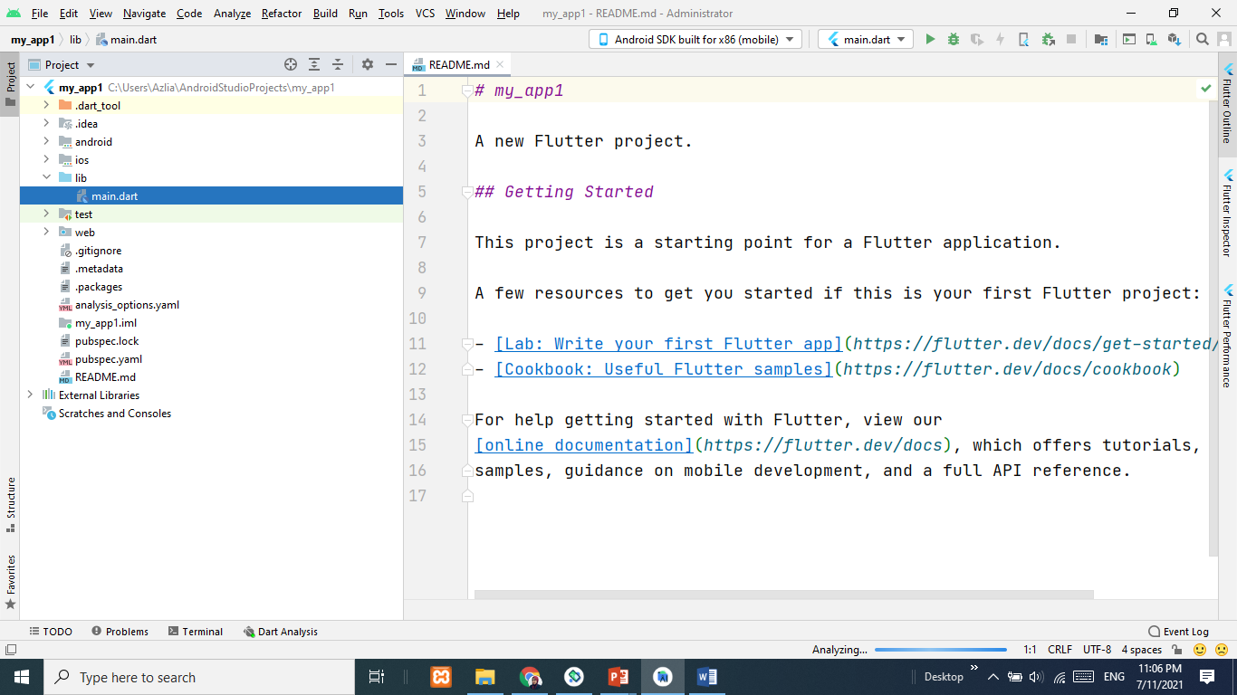
Creating Flutter Project in Android Studio
The default view is main.dart source file in lib folder:

Slide 11
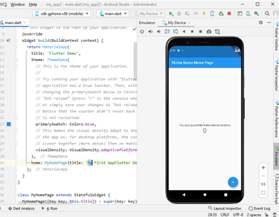
Build and Run App
To build and run the application using Android Emulator:

Slide 12
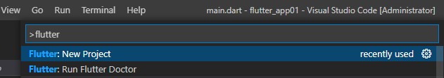

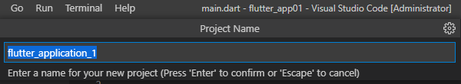
Creating Flutter Project in VS Code
Invoke View > Command Pallete to create new Flutter project. Then, give a project name.

Slide 13
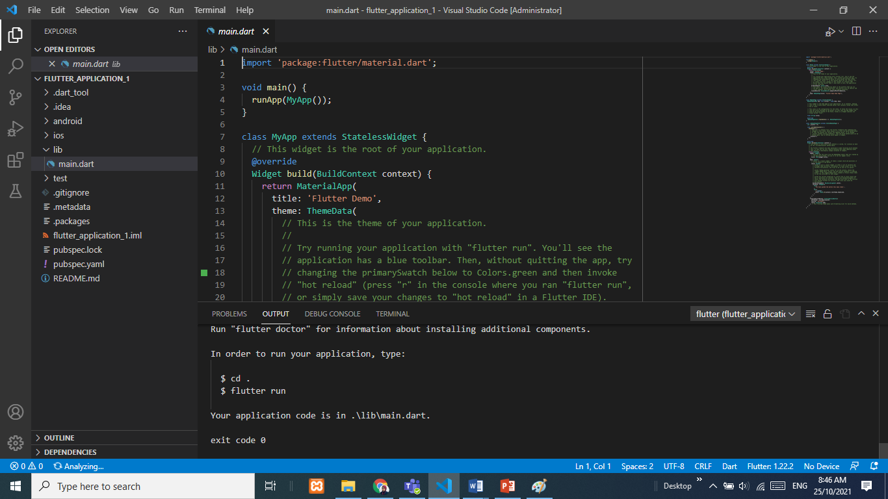
Creating Flutter Project in VS Code

Slide 14

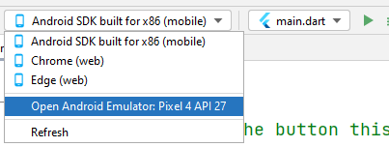
Build and Run App
To build and run the application on your smartphone device:

Slide 15
Project Structure
android/ios: This contains the platform-specific codes
flutter_application_1.iml: This is a typical IntelliJ project file, which contains the JAVA_MODULE information used by the IDE.
lib directory: This is the main folder; that will contain main.dart file to start work on.
pubspec.yaml and pubspec.lock: This pubspec.yaml file is what defines a Dart package.
README.md: This is a standard README document
test directory: This contains all the test-related files of the project

